Slide 1

INSTITUTE : UIE
DEPARTMENT : CSE
Bachelor of Engineering (Computer Science & Engineering)
Mobile Application Development(20CST-355)
TOPIC OF PRESENTATION:
Introduction to Android, Cost of Mobile Application Development,
Prepared by:
Parveen Kumar Saini(E13339)
DISCOVER . LEARN . EMPOWER

Slide 2
Introduction to Android Development Environment

Slide 3
What is Android?
Android is an open source and Linux-based Operating System for mobile devices such as smartphones and tablet computers. Android was developed by the Open Handset Alliance, led by Google, and other companies.
The first beta version of the Android Software Development Kit (SDK) was released by Google in 2007 where as the first commercial version, Android 1.0, was released in September 2008.
On June 27, 2012, at the Google I/O conference, Google announced the next Android version, 4.1 Jelly Bean. Jelly Bean is an incremental update, with the primary aim of improving the user interface, both in terms of functionality and performance.

Slide 4
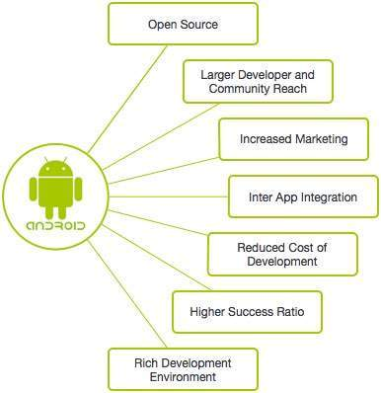
Why Android ?

Slide 5
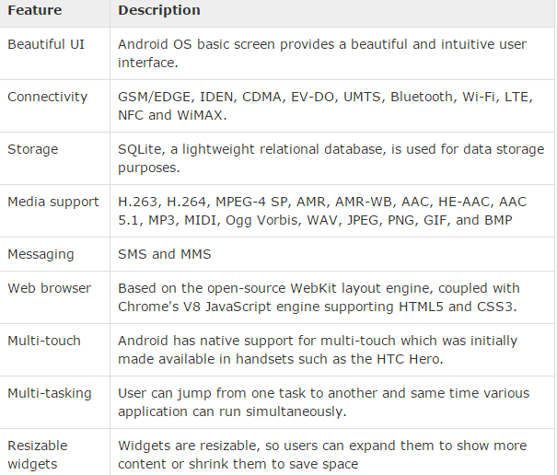
Features of Android

Slide 6
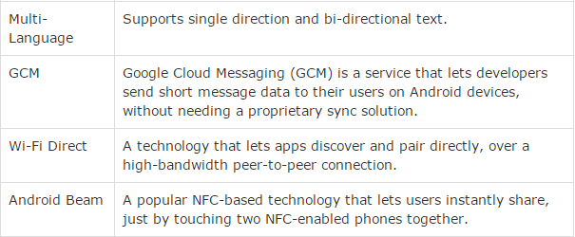
Features of Android

Slide 7
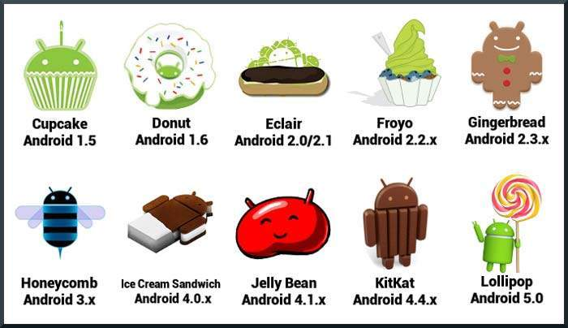
History of Android

Slide 8
What is API level?
API Level is an integer value that uniquely identifies the framework API revision offered by a version of the Android platform.

Slide 9
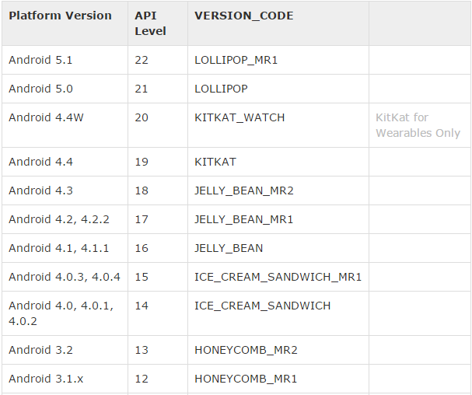
API Levels

Slide 10
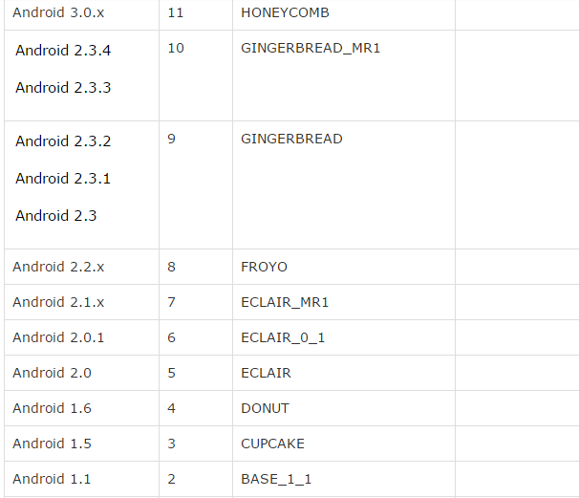
API LEVELS

Slide 11
Android - Environment Setup
Following is the list of software's you will need before you start your Android application programming.
Java JDK5 or later version
Android SDK
Java Runtime Environment (JRE) 6
Android Studio
Eclipse IDE for Java Developers (optional)
Android Development Tools (ADT) Eclipse Plug-in (optional)

Slide 12
Set-up Java Development Kit (JDK)
You can download the latest version of Java JDK from Oracle's Java site: Java SE Downloads. You will find instructions for installing JDK in downloaded files, follow the given instructions to install and configure the setup. Finally set PATH and JAVA_HOME environment variables to refer to the directory that contains java and javac, typically java_install_dir/bin and java_install_dir respectively.
If you are running Windows and installed the JDK in C:\jdk1.6.0_15, you would have to put the following line in your C:\autoexec.bat file.
set PATH=C:\jdk1.7.0_75\bin;%PATH% set JAVA_HOME=C:\jdk1.7.0_75 Alternatively, you could also right-click on My Computer, select Properties, then Advanced, then Environment Variables. Then, you would update the PATH value and press the OK button.
On Linux, if the SDK is installed in /usr/local/jdk1.6.0_15 and you use the C shell, you would put the following code into your .cshrc file.
setenv PATH /usr/local/jdk1.7.0_75/bin:$PATH setenv JAVA_HOME /usr/local/jdk1.7.0_75
www.cuchd.in Computer Science and Engineering Department

Slide 13
Android IDEs
Android Studio
Eclipse IDE

Slide 14
An Overview on Average Mobile App Development Cost Estimate
The tentative cost to make a mobile app can range somewhere from $25,000 to $150,000 and can also exceed $300,000 in case of customized complex apps.
We used tentative because the custom mobile app development cost depends on several factors such as the app’s complexity, features and functionalities, development approach and more.

Slide 15
Important factors contributing to the cost of mobile app development.
Once you are familiar with these factors, you can estimate how much it costs to build an app using the standard calculation formula.
The formula or the answer to how much does it cost to create an app lies in calculating the number of hours it would take for every single development process and multiplying it to the billable hours of resources.

Slide 16
Important factors contributing to the cost of mobile app development.
UI/UX design hours.
Platform wise app development hours.
Backend server hours.
Hourly rate of development.

Slide 17
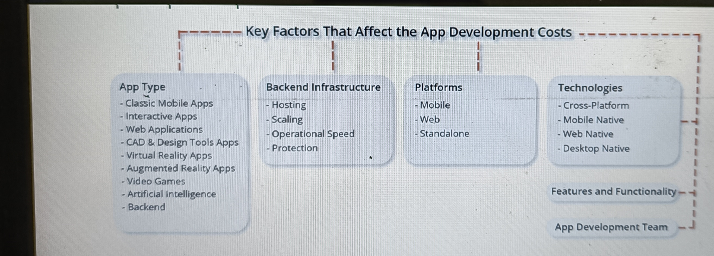

Slide 18
Mobile App Development Budgets Spent By Famous Startups
To make it easier to understand the mobile app development prices, we have prepared a collection of facts about famous brands that received funding in a seed round to continue building their mobile apps.
Uber. The company got $200K in seed funding.
Instagram. This app received $500K for further development.
Tinder. This romantic app got $485K in the seed round in 2012.
Postmates. The brand raised $750K to implement its ideas.
Snapchat. This social media giant got $485K in 2012, which fees not so much if to compare the total funding of $3B.

Slide 19
THANK YOU
For queries
Email: parveen.e13339@cumail.in

